Slide 1

Artificial Intelligence
Dr. Piyush Joshi

Slide 2
Searching

Slide 3
Searching
The agent’s task is to find out how to act, now and in the future, so that it reaches a goal state.
Before it can do this, it needs to decide what sorts of actions and states it should consider.
The process of looking for a sequence of actions that reaches the goal is called search.
A search algorithm takes a problem as input and returns a solution in the form of an action sequence.

Slide 4
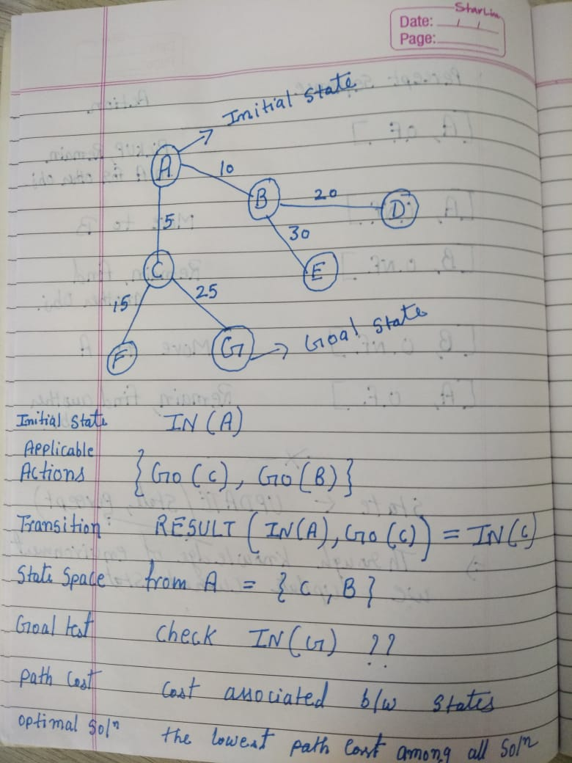
Basic concepts of searching

Slide 5
UNINFORMED SEARCH STRATEGIES
The UNINFORMED term means that the strategies have no additional information about states beyond that provided in the problem definition.
All they can do is generate successors and distinguish a goal state from a non-goal state.
Strategies that know whether one non-goal state is “more promising” than another are called informed search or heuristic search strategies.

Slide 6
Breadth-first search
Breadth-first search is a simple strategy in which the root node is expanded first, then all the successors of the root node are expanded next, then their successors, and so on.
This algorithm works in FIFO queue manner.
In other words, searching is achieved level by level in the tree.

Slide 7
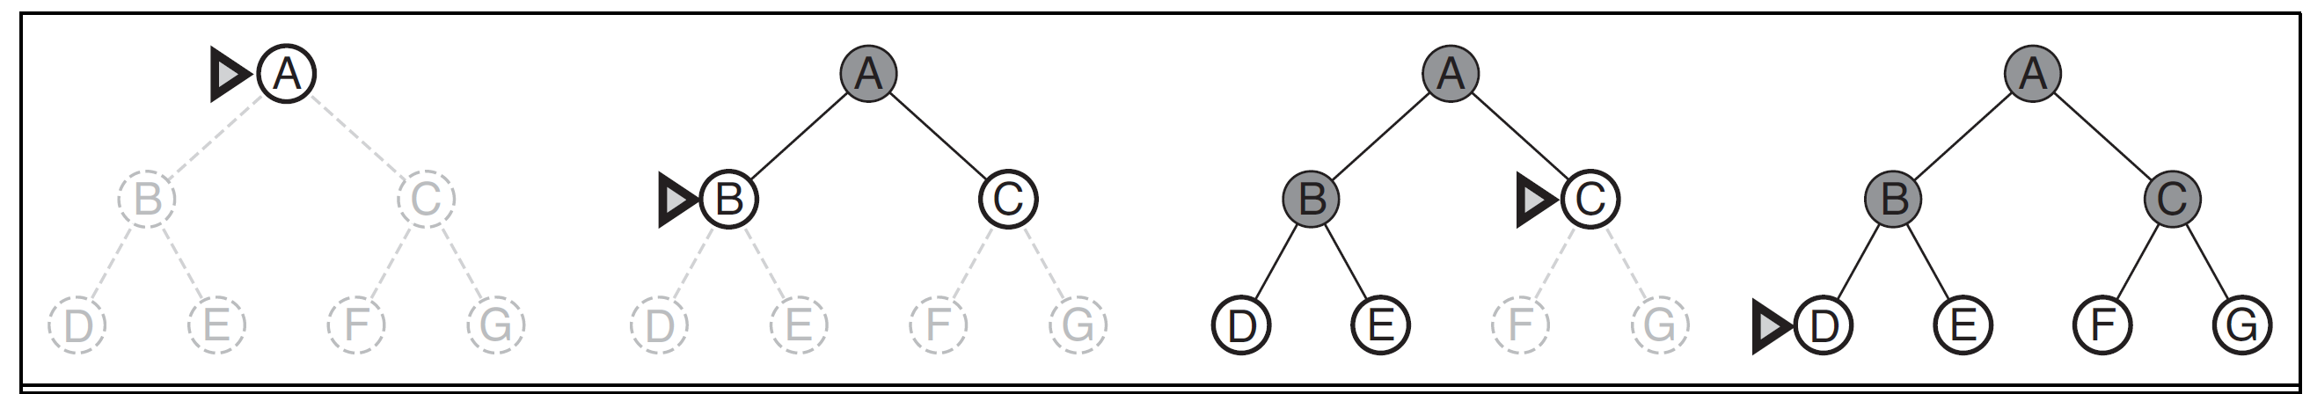

Slide 8
Breadth-first search
Completeness: Is the algorithm guaranteed to find a solution when there is one? - - YES
Optimality: Does the strategy find the optimal solution? --YES

Slide 9
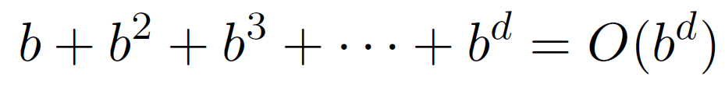
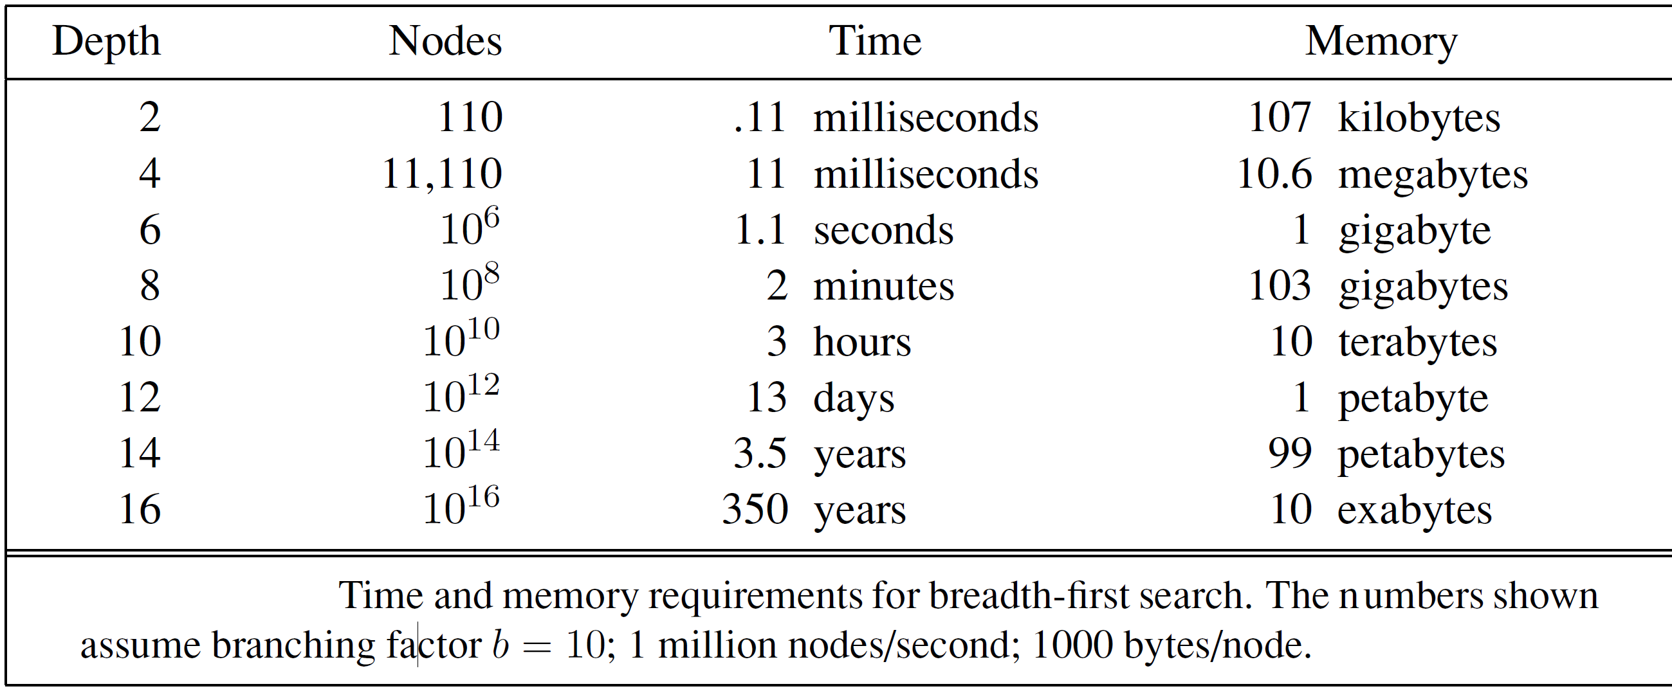
Breadth-first search
Time complexity
Total no. of nodes generated
Here, b is branching factor and d is the depth of a tree.
Space complexity will be same as time complexity.

Slide 10
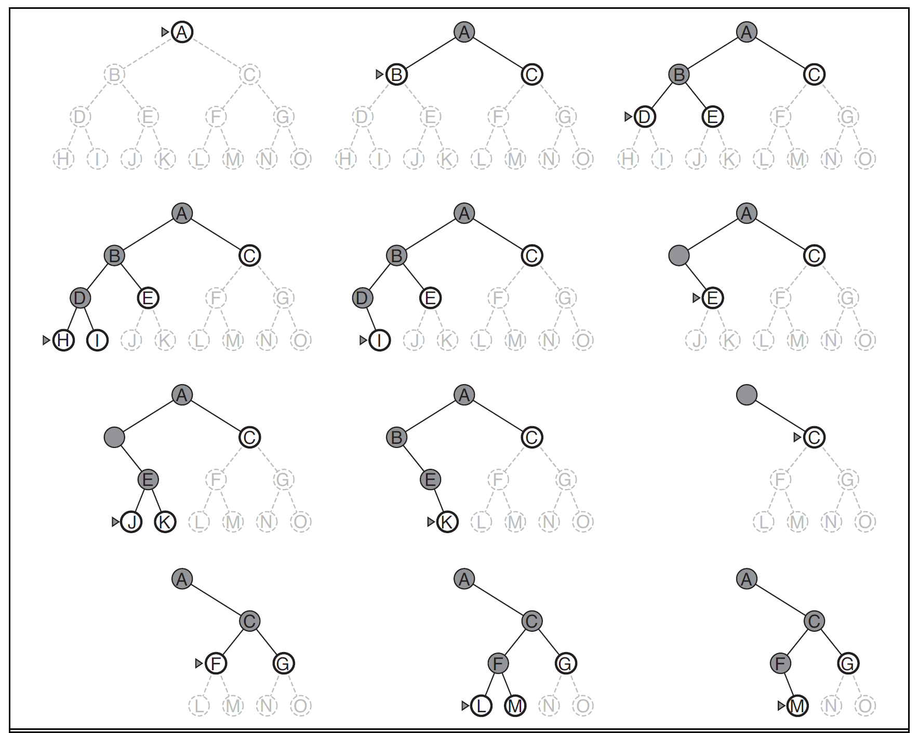
Depth-first search
Depth-first search always expands the deepest node.
It uses a LIFO (also known as stack), that means the most recently generated node is chosen for expansion.

Slide 11
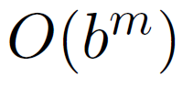
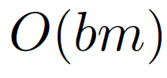
Depth-first search
Complete – Finite search space but incomplete if there is a loop in tree.
Not Optimal
Time complexity
Space Complexity
Here, m is the maximum depth of any node.
Depth-first tree search needs to store only a single path from the root to a leaf node.
Once a node has been expanded, it can be removed from memory as soon as all its descendants have been fully explored.

Slide 12
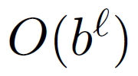
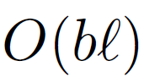
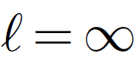
Depth-limited search
The failure of depth-first search in infinite state spaces can be alleviated by supplying depth-first search with a predetermined depth limit .
Time complexity
Space complexiy
Depth-first search can be viewed as a special case of depth-limited search with

Slide 13
Iterative deepening depth-first search

